Slide 1


Achieving Results for
Outdoor America
IWLA Strategic Plan
2014-2019
Notes:
Thank you for the opportunity to talk with you today about the Izaak Walton League’s new strategic plan and the conservation and outdoor recreation goals we have set for ourselves.
I want to give you a quick overview of the strategic goals and highlight specific actions the national organization, chapters, and members can take this year to begin achieving these goals.
I am happy to answer any questions you have or ensure that League staff get back to you with an answer.

Slide 2
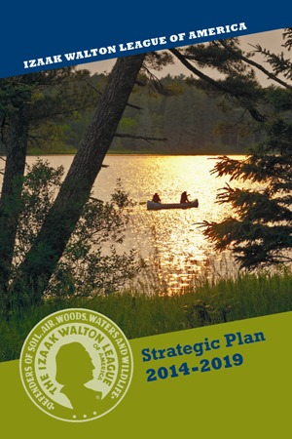
IWLA Strategic Plan
Provides focused goals for the future of the League
Goals are for the organization as a whole
Developed with extensive member input
Unanimously approved by delegates at 2013 IWLA national convention
National organization, chapters, and members all play key roles in achieving results
Notes:
A strategic plan lays out the organization’s most important goals, provides focus, and sets priorities.
The conservation and outdoor recreation goals in this strategic plan are for the Izaak Walton League as a whole – for all of us, not just the national office or chapter leaders.
All League members were invited to participate in developing the plan, and we received extensive input from members. Chapter delegates to the 2013 National Convention voted unanimously to adopt the strategic plan.
The national organization, chapters, and members all have important roles to play in achieving our shared goals and strengthening the organization for the future.

Slide 3
League’s Conservation and
Outdoor Recreation Goals
Strategic plan includes 6 broad conservation and outdoor recreation goals
Goals for the organization as a whole
Goals
  reflect input from members
  build on League’s strengths at chapter, division, and national levels
  focus on achieving tangible results
Notes:
Strategic goals describe what the organization intends to achieve. They should be broad-based and are not limited to what can be accomplished in the 5-year duration of the plan.
Each part of the League brings unique skills and strengths to achieving our goals. By combining those strengths across divisions, chapters, and our more than 44,000 members, the League can achieve every one of these goals and more.
The goals all tie back to member input received throughout the strategic planning process:
Connecting kids to conservation and outdoor recreation were over-arching priorities for members.
Conserving fish, wildlife, and their habitat and protecting clean water were the top conservation priorities.
Outdoor recreation activities are important to members and attract people to chapters. And our members are interested in a diverse array of outdoor recreation activities and promoting that diversity.
Raising the League’s visibility and boosting name recognition were consistent themes during the planning process and reflect member priorities over time.
Comments from member surveys and during town hall meetings emphasized improving internal League communications, doing more to connect members together, and how chapters value receiving more support from the national organization.
The strategic plan goals focus on achieving real results in these areas and more. I will briefly highlight each of the goals and some of the specific actions that will be taken to achieve them.

Slide 4
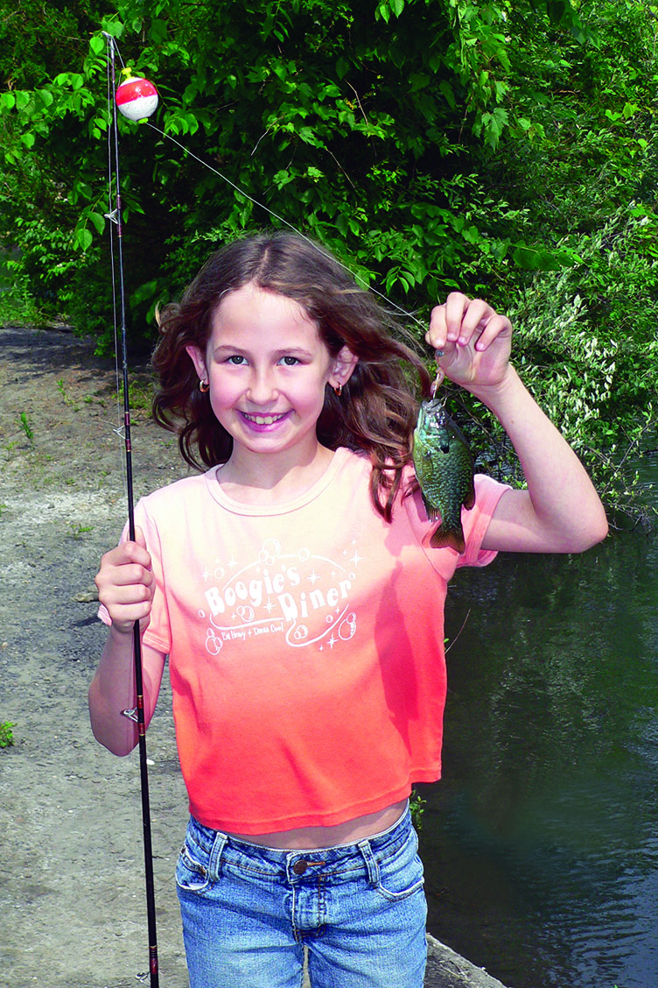
GOAL: Connect more young people to conservation and outdoor recreation.
To achieve this goal, the League will:
Provide chapters with support and training on engaging youth
Expand League programs and memberships for youth and families
Use technology and social media to engage youth
Connect youth with shooting sports, fishing, and other outdoor recreation activities at chapters
Notes:
Connecting youth to conservation and outdoor recreation is a top priority across the League.
Those connections are made at chapters across the country. That’s where kids catch their first fish and enjoy shooting sports safely and responsibly. That’s where kids learn about the importance of clean water or get their hands dirty helping to clean up a stream or plant some trees.
The more specific actions under this goal are designed to leverage the strength and experience of the chapters and members at the community level.
At the same time, the national organization and staff are committed to providing the tools, training, and support chapters need to engage and connect with youth.

Slide 5
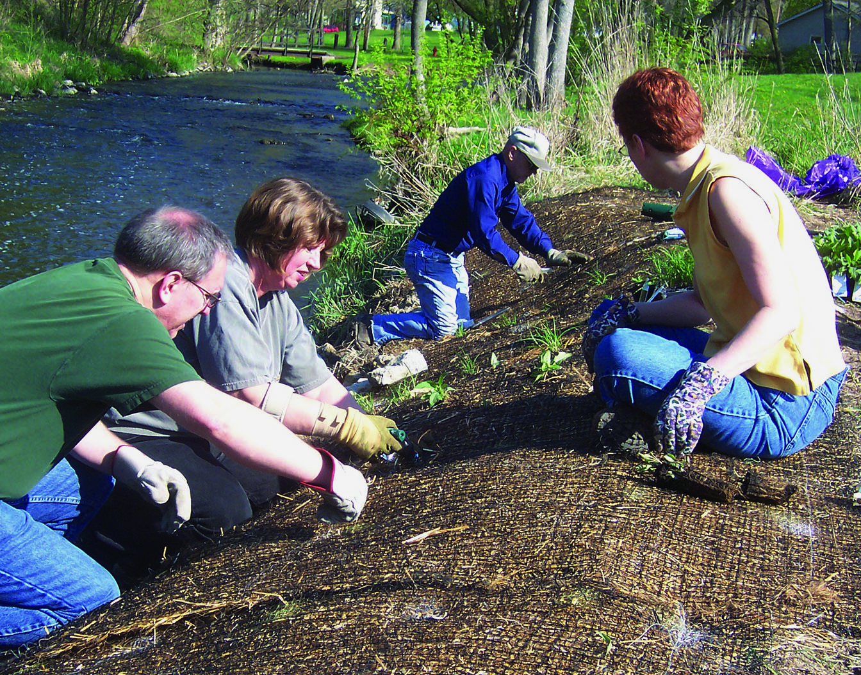
GOAL: Conserve and restore habitat to support healthy, sustainable fish and wildlife populations.
To achieve this goal, the League will:
Carry out and support local and regional projects
Advocate for policies/ funding to conserve habitat
Advocate for policies to reduce impact of energy use and production
Expand grassroots network of hunters/anglers to advocate for conservation
Notes:
Conserving fish and wildlife populations and their habitat have been consistently high priorities for League members.
Many chapters are already doing restoration projects on their property or in their communities, which provides a great foundation on which we can build – here and across the country. At the national level, the League is committed to developing partnerships to support local habitat and wildlife restoration projects.
We also know that government policies affect how development impacts land, water, and other natural resources. Working together, League staff and members can make real progress on policies that protect clean water and wildlife habitat and support development of renewable energy.
To support this policy work, the League will work to mobilize more hunters, anglers, and others who care about the outdoors to be advocates for conservation.

Slide 6
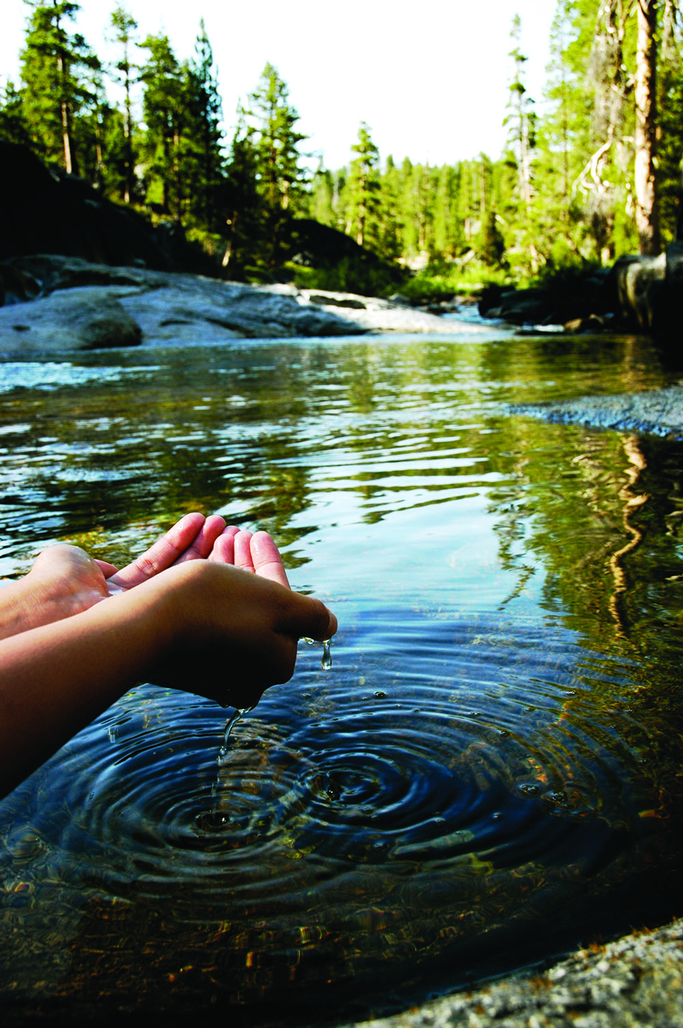
GOAL: Ensure America’s streams, rivers, lakes, and other waters are safe for fishing, swimming, and other uses.
To achieve this goal, the League will:
Engage more people in water quality monitoring
Support stream restoration
Use water-based activities to connect youth with the outdoors
Advocate for agriculture, energy and other policies that protect water quality and wetlands
Notes:
Protecting clean water plays to the League’s strengths, including our commitment to science and our decades of experience empowering citizens to solve water quality problems locally.
The League pioneered citizen-based stream monitoring with the Save Our Streams program, and we can use SOS to improve water quality nationwide, restore America’s streams, and engage a new generation of clean water advocates.
Connecting youth to conservation and outdoor recreation is an over-arching League goal. The League’s Creek Freaks program has dozens of hands-on activities that use local waters to connect kids with conservation and the great outdoors. League staff can provide on-site training to help chapters and members engage kids using these activities.
The League has been fighting for more than 90 years for policies that will improve water quality, conserve wetlands, and safeguard our great rivers. Advocacy on these issues is just as important today, when we face a weakened Clean Water Act, federal farm policies that subsidize wetland drainage, and new technologies for extracting oil and natural gas that are outpacing decades-old government policies designed for more conventional development.

Slide 7
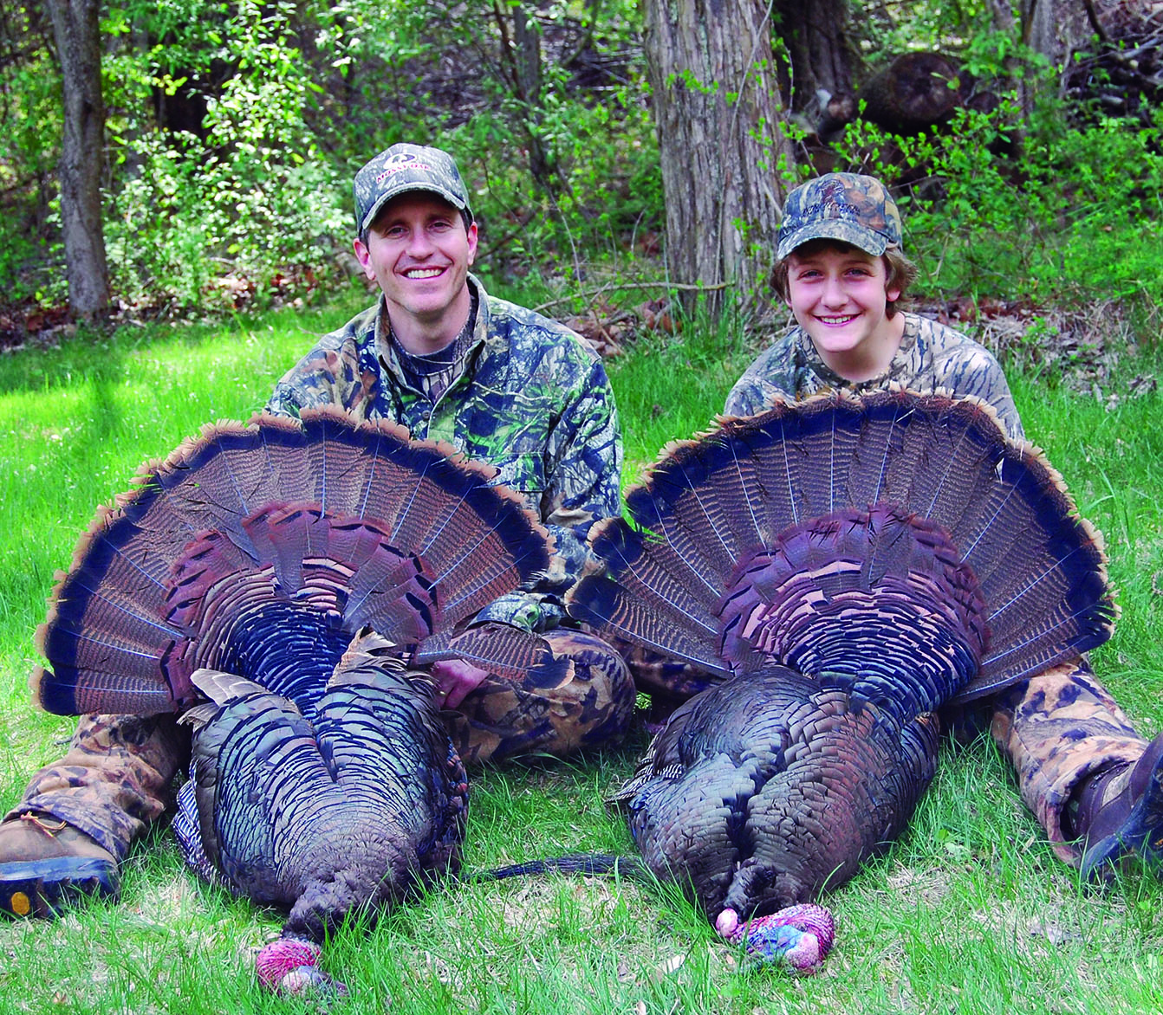
GOAL: Engage more people in sustainable outdoor recreation.
To achieve this goal, the League will:
Promote outdoor activities that engage families
Provide opportunities for more people and new audiences to enjoy shooting sports, fishing, other outdoor recreation
Mentor youth and adults interested in hunting
Notes:
Promoting outdoor recreation has been a fundamental part of the League’s mission since our earliest days.
Throughout the strategic planning process, members stressed that to reach more youth, it’s essential to engage their families too. With input from chapters about their needs, the national organization can help develop engaging family activities.
Recreational shooting sports are a passion for thousands of League members, and about half of all League chapters have shooting sports facilities. The League has the facilities and skilled members to connect more Americans with shooting sports.
We all know the population of the country is becoming increasingly diverse. As demographics shift, we need to attract new participants – including young women and more diverse ethnic groups – to activities like hunting and shooting sports.
As a smaller proportion of the U.S. population hunts, children interested in hunting may not have a family member who can mentor them, and many adults face similar challenges. League members are mentoring new hunters today, and many chapters provide hunter education training. Once again, chapters are well-positioned to mentor new hunters, which is key to sustaining hunting participation in the future.

Slide 8
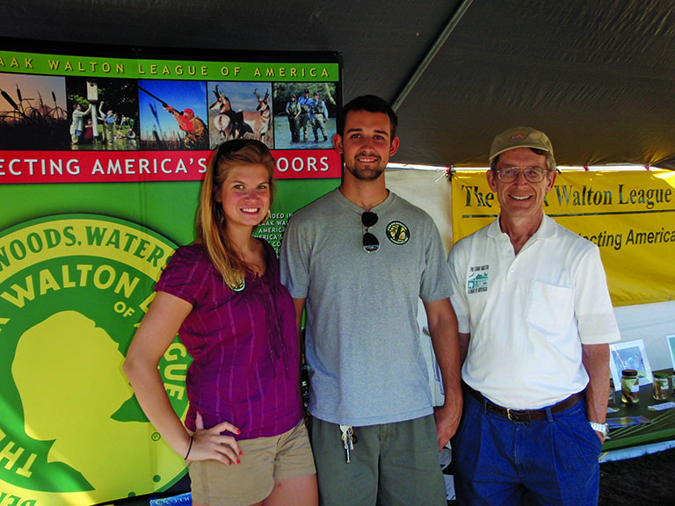
GOAL: Raise the profile of the League as a leading voice for common-sense conservation and sustainable outdoor recreation.
To achieve this goal, the League will:
Provide communications support to chapters
Connect with local and national news media
Improve Web presence and use of social media to promote the League
Notes:
Raising the visibility of the League is a long-standing priority.
This goal focuses on communications nuts and bolts, getting the word out, and engaging the media at the local, state, and national levels. From the national level, the League is committed to providing chapters with support and tools to promote their successes locally.
Ideally, the Izaak Walton League would be a household name. To achieve a goal like that, we have to communicate to the American people, media, and policy-makers about the results we’re achieving – how many kids we’ve connected with fishing, how many streams we’re cleaning up, or how many adults have learned to shoot for the first time at a League chapter. With results from the chapters, the national organization can foster media attention by combining local accomplishments to tell a compelling story about the League.
Improving technology is also a League priority. Social media is increasingly the way people – especially younger people – share information, tell others about what they like, and promote the organizations with which they are involved. At the national level, the League is committed to modernizing technology and leveraging social media to connect people with the League and one another.

Slide 9
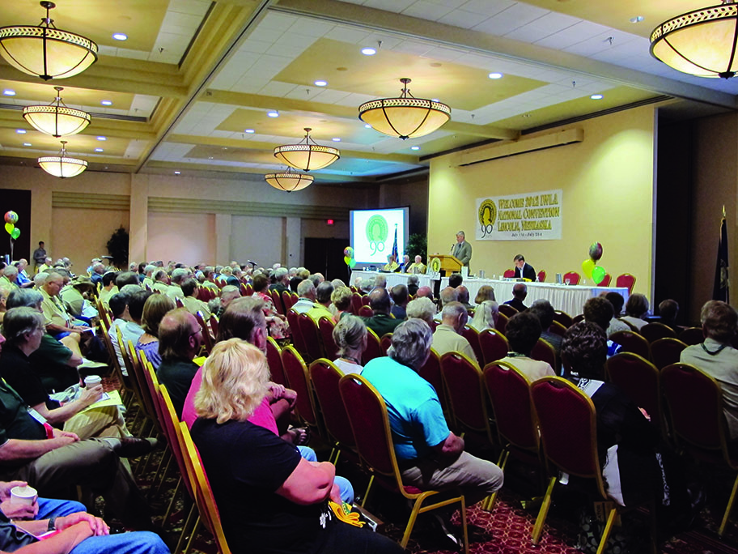
GOAL: Strengthen partnerships among all levels of the League to advance the League’s mission.
To achieve this goal, the League will:
Improve communication among all levels, including in-person
Provide training, tools, and project ideas for members
Utilize technology to link members together to share knowledge, experience
Automate membership processing where possible
Notes:
Strengthening internal partnerships is important for the future of the League.
Each level of the League has unique strengths and responsibilities. The organization as a whole is most effective when we utilize these strengths in a coordinated way, working together to accomplish our conservation and outdoor recreation goals. National leaders and staff are committed to strengthening partnerships within the League.
During the strategic planning process, members also highlighted the importance of face-to-face interaction between chapter members and national leaders and receiving support to achieve our shared goals. In 2014, national leaders and staff will meet with more chapters locally and begin developing tools and resources to help chapters achieve these goals.
It’s also important to make greater use of technology to connect League members and leaders to one another. To make it easier for members to benefit from each other’s experiences and expertise, the League is creating online forums for direct member interaction.
In town hall meetings, we heard quite a lot about the League’s membership process: too much paperwork, too slow, or all members should be able to renew and pay online. The purpose of the strategic plan is not to tackle the membership process. However, with this feedback in mind, the national organization will partner with MDRs across the country to evaluate whether greater use of technology can save time, cut costs, and improve the member experience within the current chapter-based billing process.

Slide 10
Action Steps – National Organization
In 2014, the national organization will prioritize the following:
Visiting chapters
Surveying chapters about youth engagement and outdoor recreation; developing tools/resources based on input received
Providing on-site support and training for engaging youth and stream monitoring
Providing communications tools and resources to chapters/members
Modernizing League technology
Notes:
As we work to achieve our goals, people at all levels of the League – from the national staff and leaders to chapter members – have important roles to play. The national organization, including staff and Board members, is committed to achieving results and providing tools, support, and other resources to chapters and members.
In 2014, the national organization will emphasize:
Face-to-face visits to chapters – National officers, Executive Board members, and staff, along with National Directors and Regional Governors, are going to be proactive this year about meeting with chapters locally.
Surveying chapters about youth engagement and outdoor recreation – In broad terms, members highlighted the importance of engaging youth and introducing more people of all ages to outdoor recreation activities. In 2014, the national organization will be reaching out to chapters for feedback about specific tools, resources, training, or other support they would find most useful to achieve these goals. The objective is to provide chapters with the support they want and need.
Providing on-site support and training for engaging youth and stream monitoring – League staff can provide training on starting or expanding youth programs; using water-based activities to teach kids about conservation, science, and technology; and using the Save Our Streams program to monitor, protect, and restore water quality in your community.
Providing communications tools and resources – The national organization is committed to raising the League’s visibility and supporting chapters with communications and community outreach. As a first step, the national organization will provide template press releases focused on common chapter activities.
Modernizing League technology and using social media more actively – The League will modernize technology used at the national level, including the League Web site, and help chapters modernize their Web sites. League staff will also help chapters harness the power of social media by offering training on using common social media tools, including Facebook and Twitter.

Slide 11
Action Steps – Chapters and Members
Chapters and members have important roles to play in achieving League goals
Taking a few actions in 2014 will make a big difference
  Share your results / highlight them locally
  Provide feedback on important issues
  Engage members in achieving goals
Notes:
Chapters and members are engaging kids, connecting people to shooting sports, and doing on-the-ground conservation work. Chapters are where the rubber meets the road in terms of achieving concrete results.
In 2014, every chapter and member can make a positive contribution by doing 3 things:
Share your results – About half of League chapters provided information to the national organization in December 2013 about the results they are achieving today. This is a good starting point for measuring progress toward achieving our goals. We know other League chapters are doing equally good work. Please share those results so the League can measure success and leverage results to raise our visibility across the country.
Provide feedback – The national organization will be asking for input about critical priorities this year. League staff will use this input to develop tools and support that chapters identify as most important and useful. Having your feedback is essential to meeting your needs and providing the support you find valuable.
Engage other members – We need to keep communicating about what we’re working to achieve and how members can help. National leaders and staff are committed to doing that, and it is tremendously beneficial when the key goals are reinforced at the chapter level.
Taking these 3 basic steps will make a meaningful difference as we move forward.

Slide 12
Measuring Progress
2013 Chapter Results:
More than 6,800 kids connected to fishing
More than 7,000 kids enjoyed shooting sports
30 chapters monitoring water quality in 113 streams
159 chapter and divisions Web sites
51 chapters on social media
Notes:
We’ve set strategic goals for ourselves, and we all want to measure our progress toward achieving those goals.
League chapters are achieving tangible results today that tie back to our goals, including:
Connecting kids with fishing
Introducing youth and adults to shooting sports
Monitoring water quality in local streams
To measure our progress this year and in the future, we need a starting point. In December, every chapter received a survey about activities that tie back to our goals. 115 chapters responded with the results you see here.
This is a good start, but we know the League is achieving much more because these numbers reflect input from less than half of our chapters. Other chapters are doing equally good work – and we need every chapter to share their successes with the League’s national office.

Slide 13
League Has Momentum in 2014
With clear goals and continued membership growth, League is in a strong position
National staff and leaders committed to achieving results, supporting chapters
Chapters play key roles in connecting people with outdoor recreation and leading conservation on the ground
Trajectory is clearly UP
Notes:
I believe the League has momentum around our common goals, and we have a clear plan to achieve those goals.
Our national leaders and staff are committed to supporting members and chapters, and the national organization will prioritize development of new tools and resources based on the feedback members and chapters provide.
Chapters also have important roles to play in achieving our goals. That’s where the engagement occurs, where conservation gets done on-the-ground, and where the public goes to learn about conservation issues and enjoy outdoor recreation.
I am confident that the League is on an upward trajectory, and I look forward to working with all of you to achieve our shared conservation and outdoor recreation goals.

Slide 14
Thank you very much!
Questions / Comments?
Read the full Strategic Plan at
www.iwla.org/strategicplan
Notes:
Thank you all for your time. I am happy to answer any questions you may have.
The complete strategic plan is available on the League’s Web site at www.iwla.org/strategicplan.

